Slide 1
Justifying Metadata?!
Charles Lakes
Notes:
The II Lakes Group, LLC

Slide 2


Justifying Metadata?!
C
Agenda:
Definition
Examples
What
Where
Why
a set of data that describes and gives information about other data.
Notes:
Sometimes referred, by end-users, as:
Properties
Tags
Labels
Stickers
Flags
Stamps
Notes
What: Provides more insight into the actual data.
Where: Part of the actual file, as the properties.
Why: Make content easier to find, measure, sort, and filters

Slide 3

CRE Company
C
@cre.company
Come join our #building team! We’re revitalizing the city with #multistory and #multifamily #housing with nice a #skyline!
building
multistory
multifamily
housing
skyline
Twitter
Twitter
Twitter
Notes:
How do you search for content in social media, like Twitter? Hashtags, which are essentially metadata tags.

Slide 4
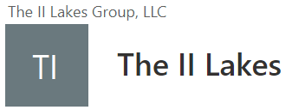


Documents
N
Twitter
SharePoint Online
SharePoint Online
Title Team Type Features
housing.png
building
;
;
housing
multifamily
skyline
multistory
C

Slide 5




TV Shows Movies Categories
N
N
Movie
Looney Vortex
Twitter
Netflix
Netflix
Comedy; Drama; Horror;
Comedy
Drama
Horror
Notes:
How do you search for streaming content? Title? Genres? Actors and/ or actresses? All metadata types.

Slide 6

Documents
Twitter
SharePoint Online
SharePoint Online
Title Type Genre
Movie
Comedy
Looney Vortex
Comedy;
Drama;
Horror;
Looney Vortex.mp4 Movie
Drama
Horror
N

Slide 7
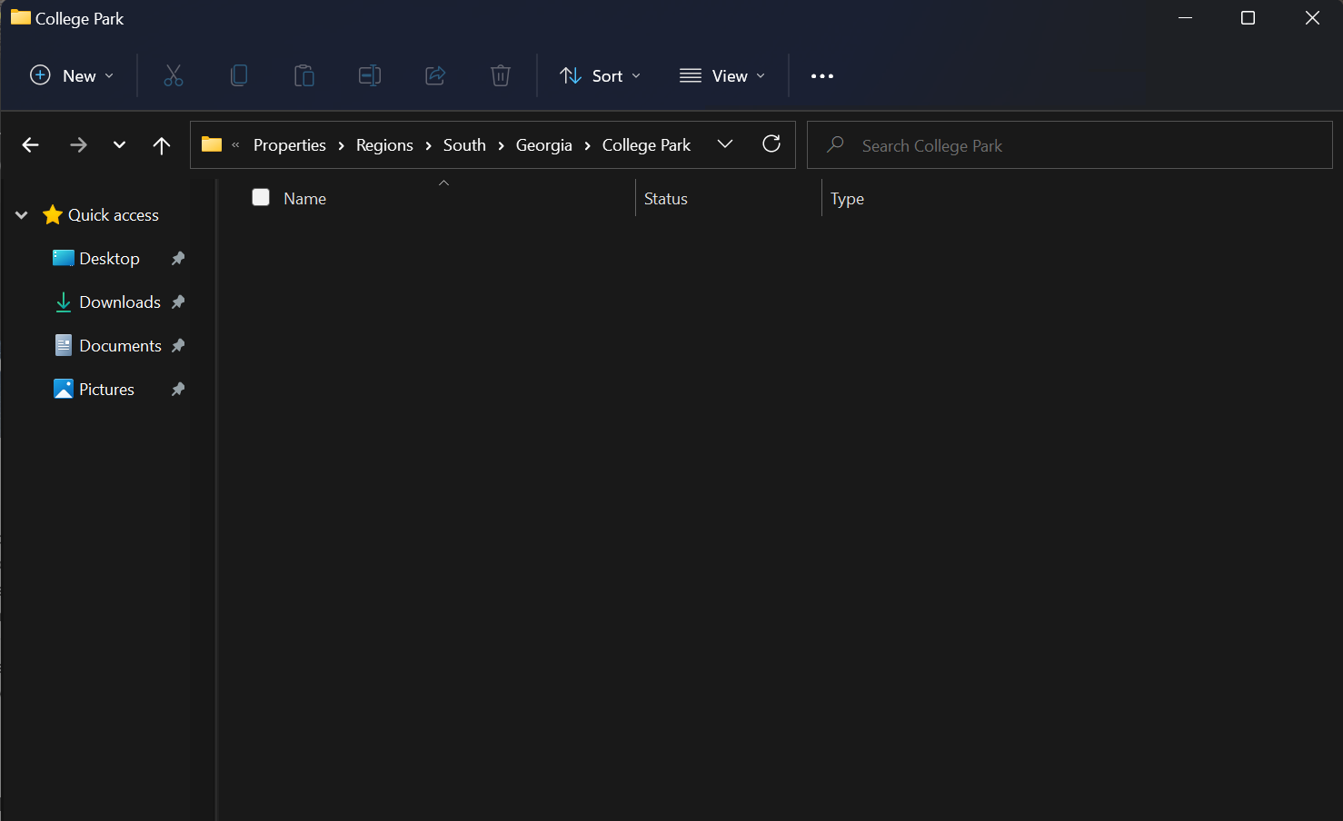

Townhouse
South
Georgia
College Park
1234 Old National
Sold
Ranch
25 Godby Rd.
Listed
Apartment
Listed
135 Creel Cir.
Twitter
Fileshare
Fileshare
Notes:
How do you organize files on the file share? Nested folders typically, but these can be turned into metadata.

Slide 8

Documents
Title Status Type Region State City
Twitter
SharePoint Online
SharePoint Online
1234 Old National
Sold
Ranch
South
Georgia
College Park
25 Godby Rd.
Listed
Apartment
South
Georgia
College Park
Listed
Townhouse
135 Creel Cir.
South
Georgia
College Park

Slide 9
Contact:
CharlesLakes.com
Notes:
The II Lakes Group, LLC

